Slide 1
OOHAPP
A PLATFORM THAT MAKES YOUR MARKETING FIT THE PERSUASION
PTICH DECK

Slide 2
ABOUT OOHAPP
OOHAPP is the perfect SaaS platform for advertising industry professionals looking to supercharge their campaigns. It uses custom AI technology to create accurate predictions and insights, allowing users to optimize campaigns based on data-driven decisions.
Our Vision
Our Mission
Our Primary Goal
At OOHAPP, we strive to be the leading Artificial Intelligence (AI) powered SaaS platform for the advertising industry.
We want to make a custom platform so that the advertising industry can become more productive and profitable
We want to provide a suite of services that will help marketers, advertisers, and publishers create, manage, and optimize their campaigns.

Slide 3
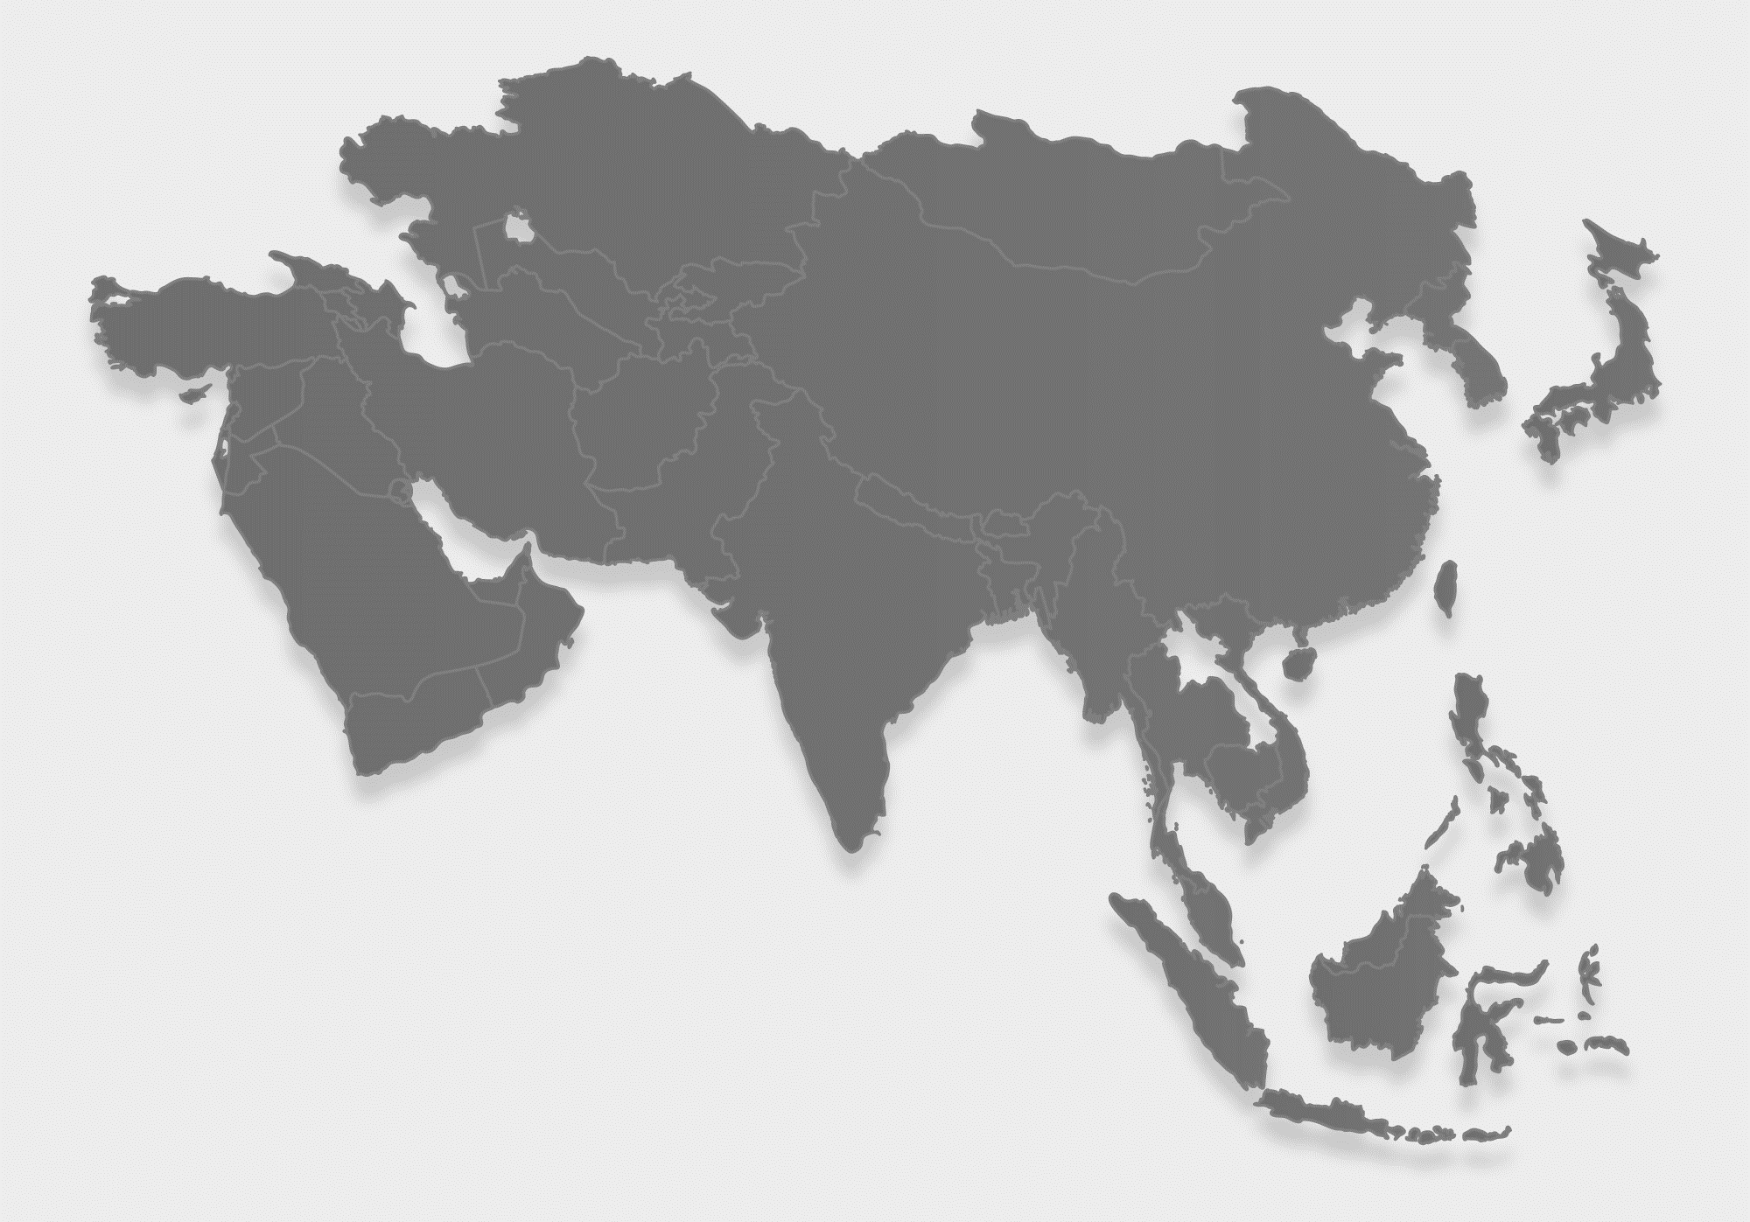
We Are Running After $31.23 Billion Market Opportunity
(by Business Research Company 2023)
14.7% Annual Growth Rate
We estimate to generate, US$65 Million (by 2024)
US$12.6 Billion
Indian Advertising Market Projected Revenue (In 2023)
3

Slide 4
PROBLEM 1
78% customer’s don’t get desired OOH Media Solutions, Huge Demand Supply Gap
Lack of Bulk Buying Mechanism
Fragmented inventory, Nothing Real-time
Lack of targeting exact audiences
Expensive for smaller businesses
Customer need affordable, result-oriented, attractive hoarding campaign for business growth
4

Slide 5
PROBLEM 2
63% customer’s Have Limited Options for Campaign Optimization, Huge Management Failure
Lack of transparency in pricing
Limited access to inventory
Unclear insights into Ad Spends
No Analytics For Future Decision
Customer need an easy hoarding campaign management mechanism for business growth
5

Slide 6
OUR SOLUTIONS
With OOHAPP, reach more customers with customized hoarding solutions tailored to your specific needs
Automated hoarding bulk booking system
Automated campaign scheduling system
AI-powered predictive analytics platform
Automated tracking of end user response
OOHAPP: Your Smartest Choice for Advertising Solutions
6

Slide 7
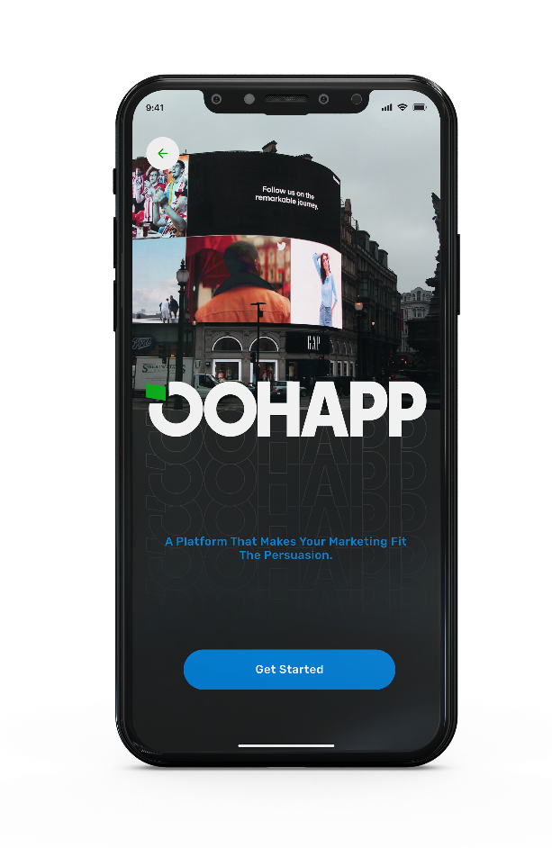
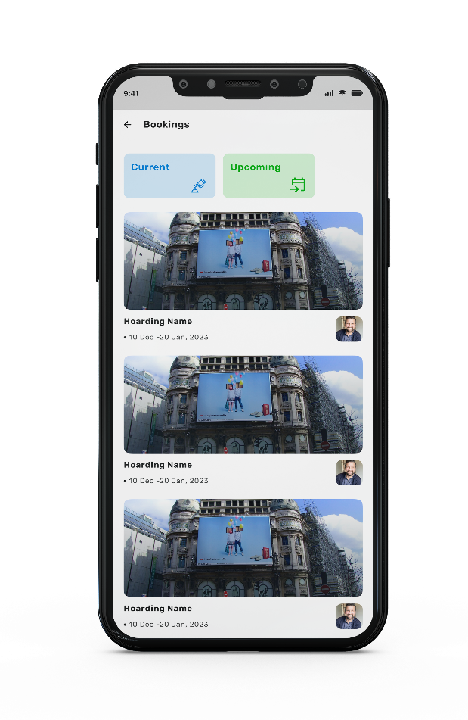
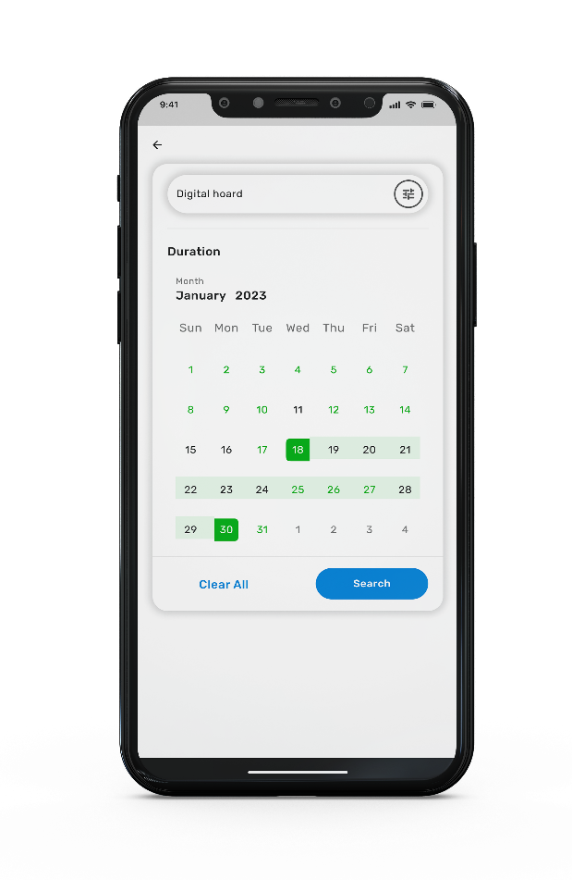
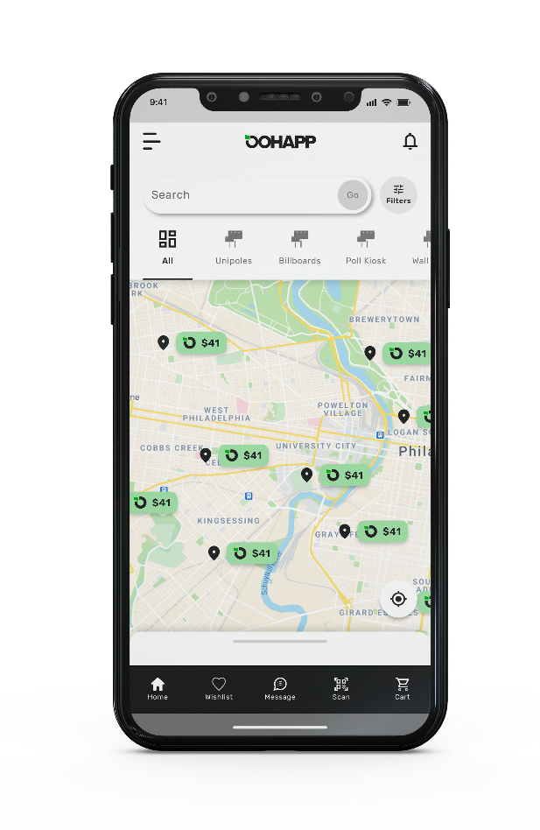
A Highly Optimized OOHAPP
Preview POC Mobile
7

Slide 8
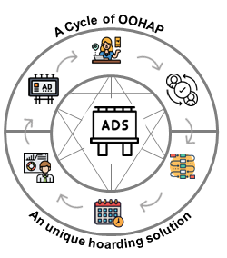
A Smartest OOHAPP
OOHAPP is AI-powered SAAS based product for advertising industry, integrated to minimize the cost of booking hoarding, billboards and other display media.
Flexible Features The SaaS interface is designed to help users quickly complete their advertising needs
Increase credibility OOHAP has been integrated to offer real-time listings, booking, insights of media expense
High Audience reach
We provide a Ai based integrated solutions to opt media & maximized audience.
Business Growth
OOHAPP allows businesses to lease, track and maintain inventory.
8

Slide 9
Traction
45.7%
Quarterly Growth
20
60+
We are growing fast, and generating a positive revenue
Employees
OOHAP
75+
53K+
Vendors Relation
Active User Signed Up
12% Average Profit Per Deal
9

Slide 10
Market Size
The advertising industry in India has witnessed rapid growth over the last few years with an estimated value of approximately US$28.48 Billion in 2022.
The total market for Outdoor Advertising in India is expected to grow at a CAGR of 19.9% during 2022-2025
OOHAPP expect quarterly growth by 12.9% and we estimate the 35.6% growth in OOH Businesses by the end of 2024 through our application.
Top MNC’s will be able to manage the campaign management, marketing strategic al-data and will appreciate the growth of 29.7% quarterly.
10

Slide 11
Revenue Model
Hoarding Buying/Selling Campaign Management
Subscription Based Hoarding Management And Data Sharing To Business Houses
OOHAPP will enter into partnerships with other media outlets to provide its services to a wider audience
UNI POLES / MONOPOLES
CENTRAL ROAD MEDIANS
METRO ADVERTISING
11

Slide 12
Growth Plan
We will generate US$82M by 2026:
YoY Growth
95%
Customer Base Value: 5M+
85%
Vendor Base Value: 20K+
65%
55%
Revenue Growth Rate: 45.7%
45%
35%
35%
30%
25%
20%
25%
20%
15%
20%
Sept2024
Dec2024
June2025
Dec2025
July2026

Slide 13
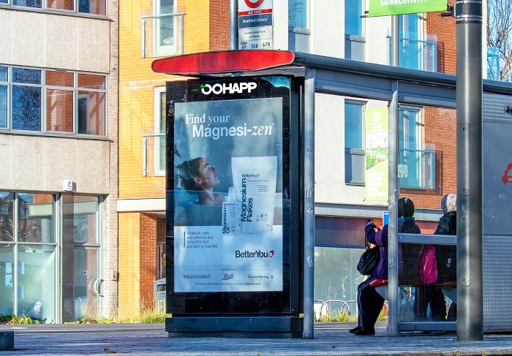
MARKETING PLAN
Influencer Marketing
Referral Program
Our focus will be on influencers that have a large and engaged audience within your target demographic.
We will offer incentives for customers that refer our app which will be a great way to achieve targeted leads.
Trade Shows and Events
Social Media Advertising
Participating in trade shows and events will be an effective way to get our app in front of B2B & B2C formats
We will leverage the platforms’ vast amount of user data to create ads and target clients
We Are Planning To Reach 200+ Cities in India by 2024
13

Slide 14
Business Competitor
We differentiate ourselves from our competitors by offering AI-powered SaaS platform that offers personalized and data-driven insights
Fast Support
Data Collecting
Unique Services
Only Real Cases
75%
60%
80%
90%
Our Competitor

Slide 15
Automated Mobile Solution
OOHAPP is AI-Powered Hoarding Booking App that makes your life easier by providing a one stop solution for all your outdoor advertising needs!
Efficiency
Cost Saving
Standardization and Cleaner Data
Application Features
OOHAPP helps to remove the vast majority of human error from processes as it’s designed to follow specific rules.
OOHAPP minimize the cost of booking hoarding services while providing brands with a convenient mechanism
The App can be used to process automation to standardize their workflow processes.
Bulk Booking
Date Management
Accurate Availability Check
Tracking And Real Time Monitoring
Create Your
Own Staff
OOHAPP provide an easy way for advertisers to showcase their products and services in a highly effective way.
15

Slide 16
Central Inventory Mechanism
Real-time inventory analysis
Reduced Negotiation Time:
Faster campaign execution
Cost Savings
Simplified Booking Process
Improved budget control
OOHAPP INVENTORY MECHANISM
Advanced Business Intelligence
OOHAPP can turn your brands’ campaign management program into a competitive advantage.
16

Slide 17
Future Milestone
The outdoor advertising industry has become more important than ever before. It's not just about billboards anymore:
Here are some of the megatrend of OOH Industry:
3D Billboards
OOH Programmatic Buying
Interactive And Engaging Creative
Structural QR Codes
17

Slide 18
Organization Structure
Managing Director
Executive Director
Advisory Board
CEO
Director Marketing
Director Finance & Accounts
Director Research & Development
Director Human Resources
Head of Product
18

Slide 19
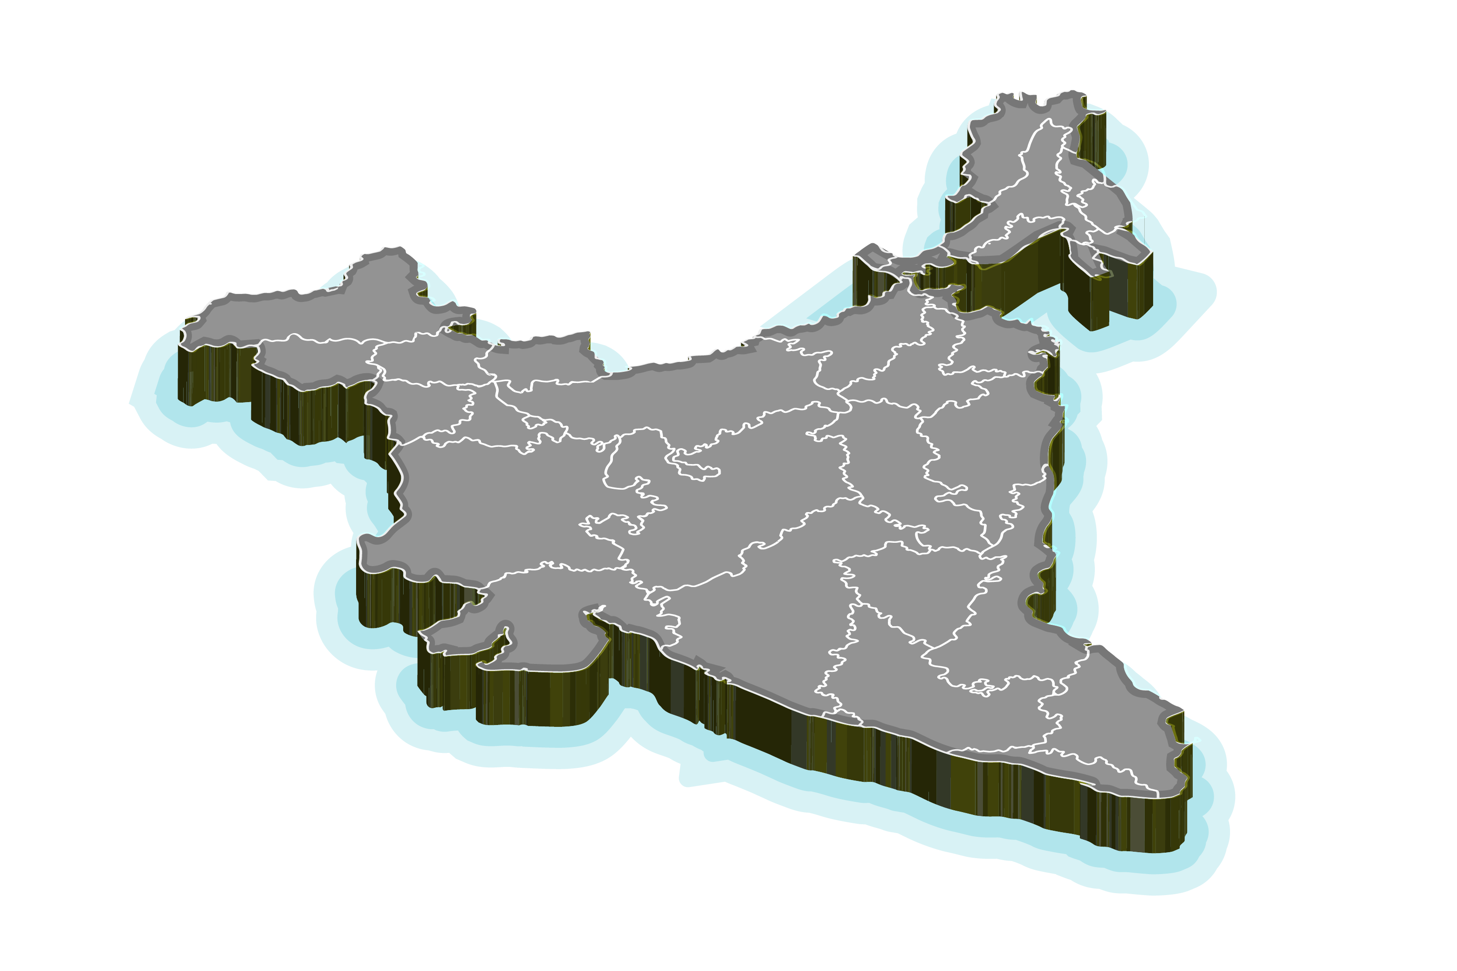
Regional Presence
INDIA
Lucknow
New Delhi
Amritsar
Nagpur
Vishakhapatnam
Mumbai
6 Cities
4 States
19

Slide 20
Board Members
PRAVEEN RASTOGI Founder & Chief Executive Officer
SUSHIL GAUTAM Chief Operating Officer
ABHISHEK TRIPATHI Head of Product
With 20+ Exp. Praveen is a leader in the field of AI and OOH media, and is dedicated to creating an environment where everyone has the opportunity to make their mark.
With 15+ Exp. Sushil is responsible for ensuring that OOHAPP is an efficient, streamlined, and cost-effective organization.
Abhishek role is to ensure that the product’s features and functionalities are of the highest quality and meet the expectations of our customers.
20

Slide 21
Funding Ask
We are seeking US$10M in funding to help us expand our reach and capabilities
For Business Setup in Regional City Like Lucknow:
Use of Funds
Increase the number of integrations and partnerships
US$5 M
Enhance our data analytics capabilities
For Business Setup in Metropolitan City Like Mumbai
Increase our marketing efforts
Expand our team to support our growth
US$25 M
21

Slide 22
Exit Plan
Our goal is to eventually bring OOHAPP to a point where we are ready for an exit and a ROI for our investors
Strategic Sale
The investors can exit by selling their stake in the venture to a strategic investor such as an advertising company
Initial Public Offering (IPO)
Investors can also exit their stake by taking OOHAPP public and selling the shares on a public exchange
Secondary Sales
Investors can also exit by selling their shares to other investors in a secondary sale.
22

Slide 23
Branch Office:
Thank you
Head Office:
B25 Third Floor, Vibhuti Khand, Gomti Nagar Lucknow Uttar Pradesh India- 226010
Mobile:
+91 9818805835
Email ID:
info@oohapp.io

Slide 24
Reference Links:
The Business Research Company: bit.ly/3JBjRBg/
Data Bridge Market Research: bit.ly/42qt48d/
Statista: bit.ly/3n6Xb4s/
Expert Market Research: bit.ly/3Tvohyi/
IMARC Group: https://www.imarcgroup.com/digital-ooh-market
The Economic Times: bit.ly/3Z3cyYY/
24

